Slide 1

Fuzzy C-Means Clustering and Cluster Quality Evaluation
GNR602- Advanced Methods in Satellite image processing

Slide 2
Introduction
Fuzzy C-Means (FCM) is a clustering algorithm that assigns each data point to a cluster with a degree of membership.
The primary objective of this project is to implement the FCM clustering algorithm and evaluate the cluster quality for different values of C (number of clusters).
m is a fuzziness parameter that controls the degree of overlap between the clusters.
The minimum and maximum values of C will be specified by the user.

Slide 3
Introduction
In this project, we will first discuss the theoretical background of the FCM algorithm and its various parameters.
Next, we will implement the algorithm using Python programming language
We will then evaluate the cluster quality for different values of C using Davies-Bouldin Index
The results of this project will provide insights into the effect of the number of clusters on the quality of clusters obtained by the FCM algorithm.

Slide 4
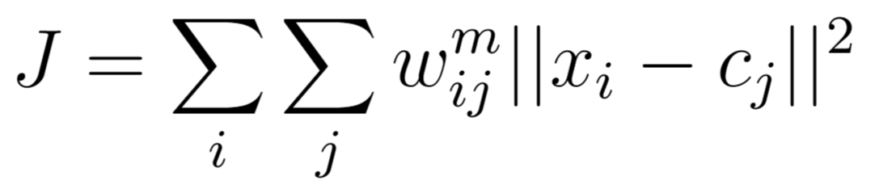
Problem
Label each pixel of the image into clusters based on a fuzzy membership of that pixel into the cluster
The objective of the FCM algorithm is to minimize the following objective function:
J is the objective function to be minimized.
wᵢⱼ is the degree of membership of data point xᵢ in cluster cⱼ.
m is a fuzziness parameter that controls the degree of overlap between the clusters.
xᵢ is the i-th pixel's feature vector.
cⱼ is the centroid of the j-th cluster.

Slide 5
Algorithm
Fix
Fix a C in the range of C specified by the user
Update
Iteratively update the membership and cluster centroids until convergence
Evaluate
Calculate the Davies Bouldin Index (DBI) for the clustering
Repeat
Repeat these steps for all values of C specified by user
Determine
Determine the optimal value of C by the minimum DBI value
Initialize
Initialize the membership matrix via K-Means (K = C)

Slide 6
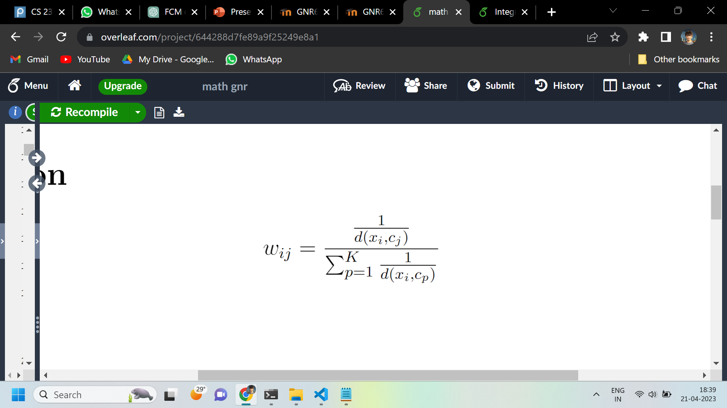
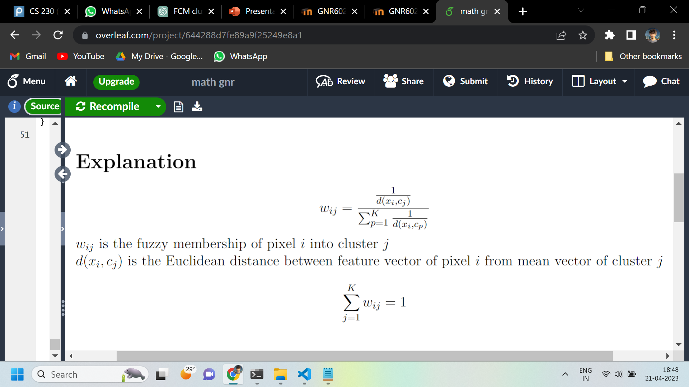
Initialize
Initialize the cluster memberships by running a few iterations (≈10) of the K-means algorithm (K = C).
Initialize the fuzzy memberships from the K Mean cluster vectors according to:

Slide 7
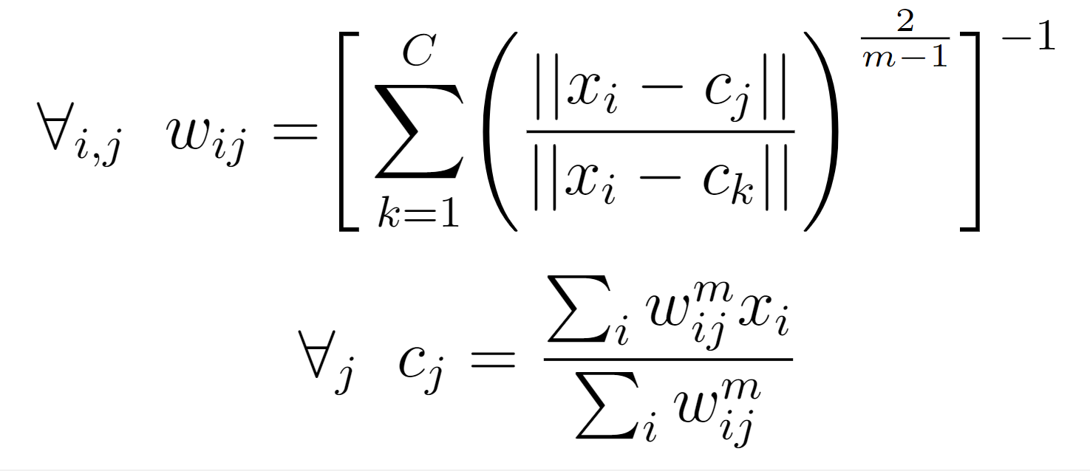
Update
Update memberships and cluster centres in each iteration as:

Slide 8
Evaluate Cluster Quality
The Davies Bouldin Score (DBI) is a measure of cluster quality that evaluates the ratio of within-cluster similarity to between-cluster dissimilarity.
The DBI is defined as the average similarity measure of each cluster with its most similar cluster, where similarity is the ratio of within-cluster distances to between-cluster distances. Thus, clusters which are farther apart and less dispersed will result in a better score.
A lower DBI score indicates better cluster quality, as it means that the clusters are more separated and have a higher degree of similarity within the clusters.

Slide 9
Silhouette Score
The Silhouette Score is calculated for each data point in the dataset by computing the mean intra-cluster distance (a) and the mean nearest-cluster distance (b), and then subtracting them and dividing by the maximum of the two (max(a, b)).
The Silhouette Score ranges from -1 to 1, where a score closer to 1 indicates that the data point is well-matched to its assigned cluster and that the clusters are well-separated from each other, and a score closer to -1 indicates that the data point may be better matched to a different cluster.
But this has high computational time complexity (more than the clustering algorithm itself). So, we didn't use this quality metric

Slide 10
Repeat & Determine
Repeat the previous steps for all values in the range of C
The optimal value of C is determined by the clustering which has the minimum Davies Bouldin Score
Dataset
Louisiana 2016 Flood Satellite Images
https://www.kaggle.com/datasets/rahultp97/louisiana-flood-2016

Slide 11
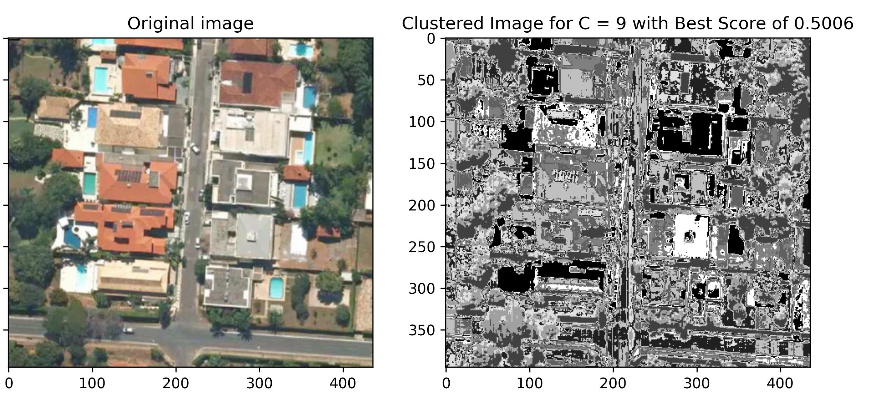
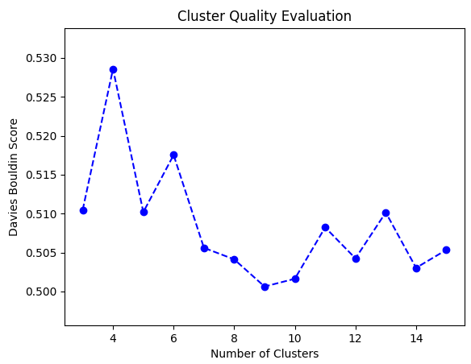
Results

Slide 12
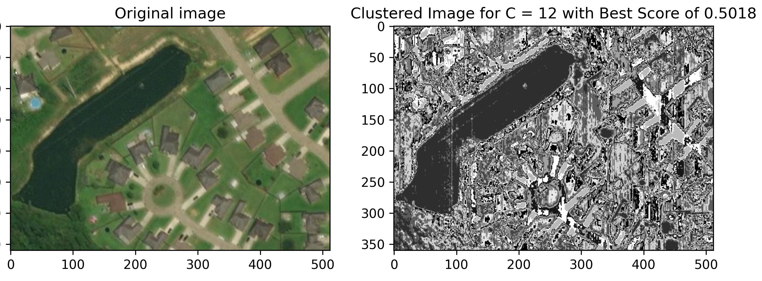
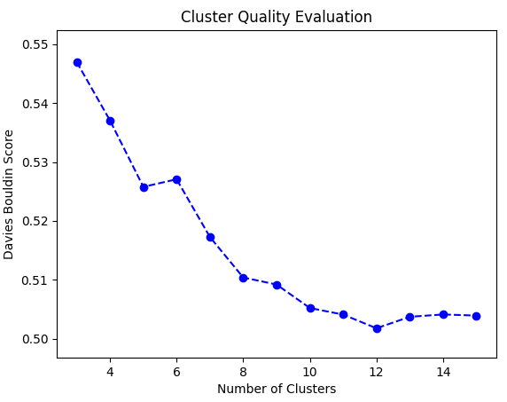
Results

Slide 13
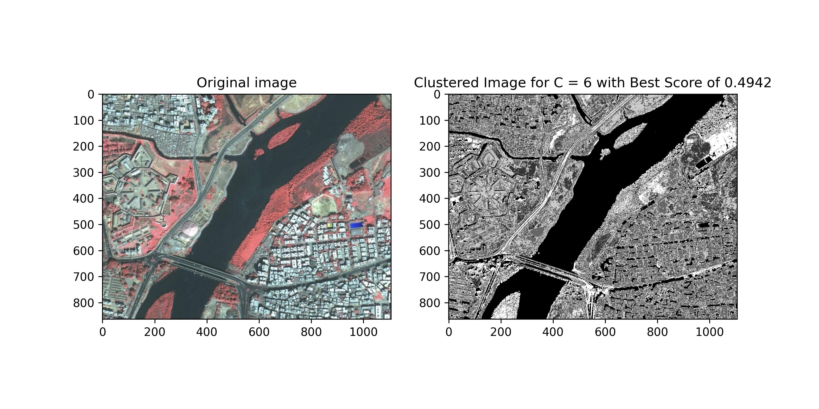
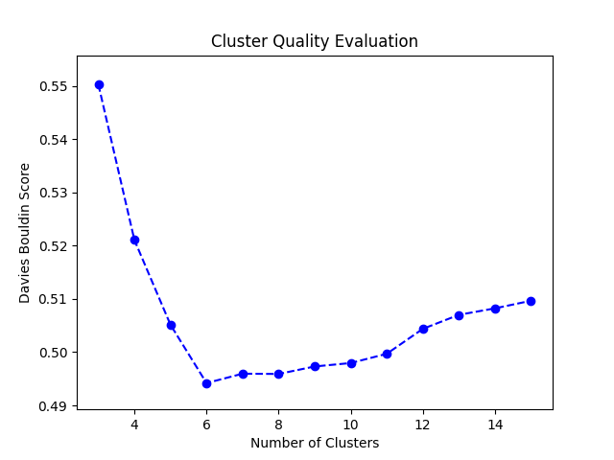
Results

Slide 14
Conclusion
A low number of clusters can result in poor cluster quality because the clusters may be too large and heterogeneous, while a high number of clusters can result in poor cluster quality because the clusters may be too small and similar.
Therefore, it is crucial to find the optimal number of clusters, which lies in the intermediate range and results in well-separated, homogeneous, and meaningful clusters.
An optimal number of clusters are needed to model various aspects captured in a satellite image such as forests, roads, buildings, water bodies, vegetation, fields, etc.

Slide 15

Thankyou
Shantanu Welling (210010076)​
Harshit Agarwal (210020054)​
Arijit Saha (210050017)​
Topic 3. Implement FCM clustering algorithm and evaluate the cluster quality for different values of ‘C’. (Minimum and maximum values of C to be specified by user) ​

